Slide 1
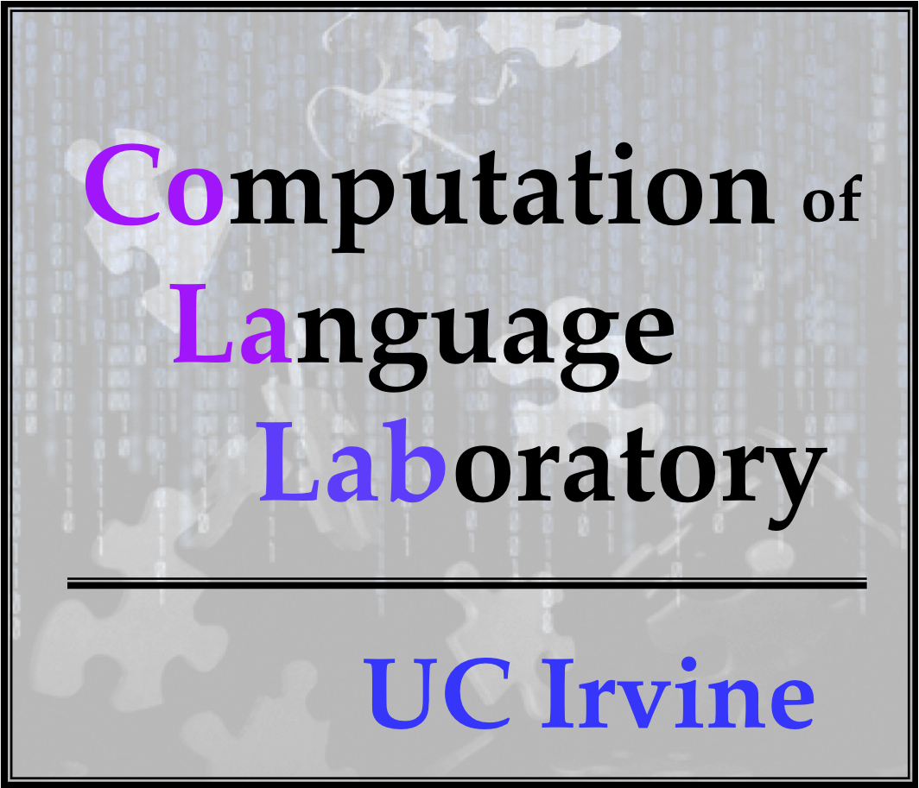



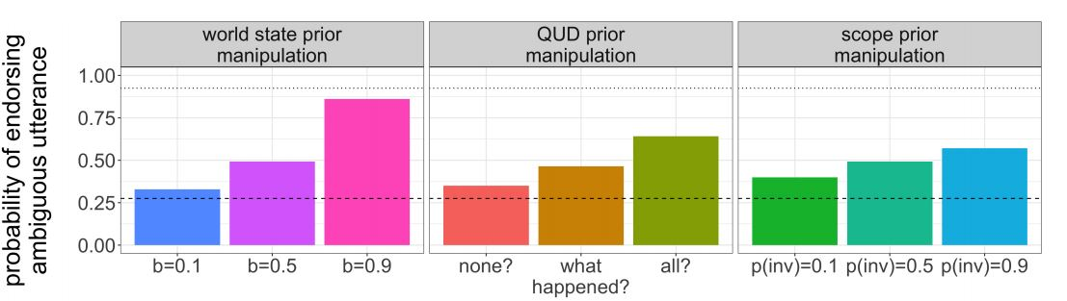




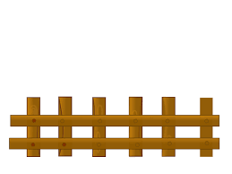
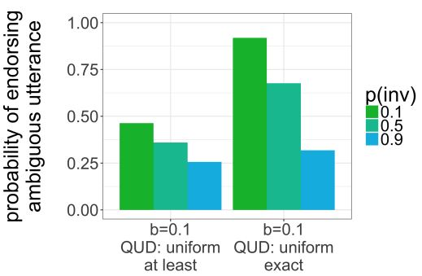
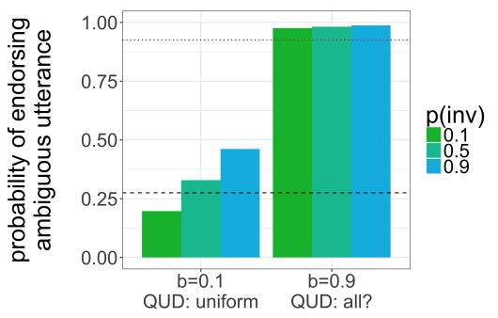


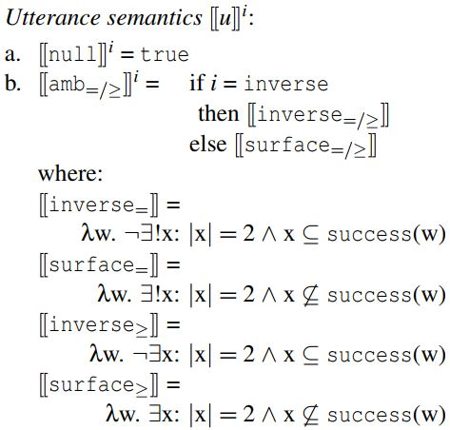
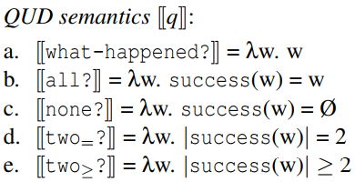




Exactly two things to learn from modeling scope ambiguity resolution: Developmental continuity and numeral semantics
K.J. Savinelli, Gregory Scontras, and Lisa Pearl
University of California, Irvine
Background
Adults exhibit surface scope preference in a situation where both interpretations are true.
Adults: 75% surface, 7.5% inverse, 17.5% unclear from explanations
Results
The linguistic phenomenon: scope ambiguity
Adult endorsement rate of two-not in the 1-of-2 and 2-of-4 context
1-of-2: 27.5%
2-of-4: 100%
every-not: Every horse didn’t jump over the fence.
a. ∀ >> ¬ (surface scope):
None of the horses jumped over the fence.
b. ¬ >> ∀ (inverse scope):
Not all of the horses jumped over the fence.
Adult behavior in TVJT can be impacted as children’s behavior is; with an explicit contrast clause.
“Two frogs jumped over the fence, but two frogs didn’t jump over the rock.”
Adult endorsement rate: 92.5% (up from 27.5%)
Two-not
Adults: 27.5%
Adult behavior is best captured when the baserate is low (0.1) an the QUD isn’t all?
The two scope operators interact with each other to produce two distinct interpretations
Open Questions
Replicates previous work modeling children’s behavior with every-not
A truth-value judgment task (TVJT) is used to measure listener endorsement
What causes the asymmetry in adult behavior across the two contexts? Is it just a strong surface scope bias?
Why does the explicit contrast clause work for adults with two-not?
Can the same mechanistic account be given for children with every-not and adults with two-not?
Adults: Children:
Fig 1. every-not: surface is true and inverse is false
Our contribution
Why do children behave differently than adults?
Extend model from Savinelli et. al. (2017) to investigate the developmental continuity hypothesis.
If the same model can account for children’s behavior in every-not and adult behavior in two-not, then we have compelling empirical evidence from computational modeling of developmental continuity.
Savinelli et. al. (2017) articulated specific pragmatic factors and grammatical factors in a computational model that impact utterance interpretation.
Bayesian Rational Speech Act (RSA) modeling framework (Frank & Goodman, 2012, Goodman & Stuhlmüller, 2013, Goodman & Lassiter, 2015)
Language understanding as recursive social reasoning between speakers
Ambiguity resolution as pragmatic inference
Reasoning about interpretations, QUDs, world states, and utterances
Two-not
Adults: 27.5% to 92.5%
Two-not
Adults: 100%
The Model
Interpretations:
i ∊ {surface,inverse}
QUDs:
q ∊ {how-many?,all?,none?,
at-least-two?,exactly-two?}
World states:
w ∊ {0,1,2} and {0,1,2,3,4}
Utterances:
u ∊ {two-not,null}
Changing the two pragmatic factors captures the behavior observed after the explicit contrast manipulation
Baserate of 0.1
Favoring all? QUD
Capturing the asymmetry: 2-frog vs. 4-frog.
Same parameter settings should give rise to the asymmetry
Need an exactly-two semantics and a P(inv) = 0.1
They modeled TVJT behavior as utterance endorsement (Degen & Goodman, 2014; Tessler & Goodman, 2016)
A pragmatic speaker, S₂, observes the true world state
S₂ chooses to utter every-not (“true!”) or nothing at all (“false!”)
Found that the pragmatic factors dealing with world knowledge and beliefs about the question under discussion (QUD) play a stronger role than a grammatical factor like scope when disambiguating every-not.
Discussion
But adults sometimes behave like children
Our model of ambiguity resolution in context captures the effect of the explicit contrast manipulation observed in adults in Musolino and Lidz (2003), and notably also captured the same effect in children
Suggests that the same disambiguation mechanism is present in both children and adults; evidence for developmental continuity.
The model also explains why the explicit contrast manipulation works: the pragmatic factors create a situation where two-not is still informative despite the ambiguity.
Musolino and Lidz (2003) were interested in developmental continuity: are child and adult ambiguity resolution behavior in context qualitatively similar?
We model pragmatic speaker behavior separately in both 2-frog and 4-frog contexts.
In the 4-frog contexts we use two additional QUD: at-least-two?/ exactly-two? and we use two different interpretations of two: an at-least-two semantics and an exactly-two semantics.
two-not: Two frogs didn’t jump over the rock
a. 2 >> ¬ (surface scope):
Two frogs are such that they didn’t jump.
b. ¬ >> 2 (inverse scope):
It is not the case that two frogs jumped.
The model also seamlessly captures Musolino and Lidz’s (2003) results from the 2-of-4 context: with the very same parameter values that yield low endorsement rates for 1-of-2 contexts
Can only do this with an exactly-two semantics
Default Values:
P(w) = baserate = 0.5
P(q) = uniform
P(surface) = 0.5
P(inverse)=0.5
Manipulated values:
P(w) = baserate range 0.1 – 0.9 by 0.4
P(q=favored) = 0.9
The model underscores the complexity of the disambiguation
- Confluence of factors contributes to how these ambiguities are resolved
- Pragmatics seems to matter more, but scope is still matters
Fig 2. 4-Frog world (2-of-4 context): surface is true and inverse is false
Fig 3. 2-Frog world (1-of-2 context): surface is false and inverse is true
Computational modeling can help us refine our theories about language
We can manipulate the semantics of two in ways experiments can’t
Two matters!
Adults: Adults:
References: Leon Bergen, Noah Goodman, and Roger Levy. 2012. That’s what she (could have) said: How alternative utterances affect language use. In Proceedings of the Cognitive Science Society. volume 34, pages 120– 125. Judith Degen and Noah D Goodman. 2014. Lost your marbles? the puzzle of dependent measures in experimental pragmatics. In Proceedings of the Annual Meeting of the Cognitive Science Society. volume 36, pages 397–402. Frank, M. C., & Goodman, N. D. (2012). Predicting pragmatic reasoning in language games. Science, 336(6084), 998–998. Noah D Goodman and Michael C Frank. 2016. Pragmatic language interpretation as probabilistic inference. Trends in Cognitive Sciences 20(11):818–829. Daniel Lassiter and Noah D. Goodman. 2013. Context, scale structure, and statistics in the interpretation of positive-form adjectives. In Semantics and Linguistic Theory (SALT) 23. pages 587–610. K.J. Savinelli, Gregory Scontras, and Lisa Pearl. 2017. Modeling scope ambiguity resolution as pragmatic inference: Formalizing differences in child and adult behavior. In Proceedings of the Annual Meeting of the Cognitive Science Society. volume 39, pages 3064–3069. Michael Henry Tessler and Noah D. Goodman. 2016. A pragmatic theory of generic language.

